Slide 1

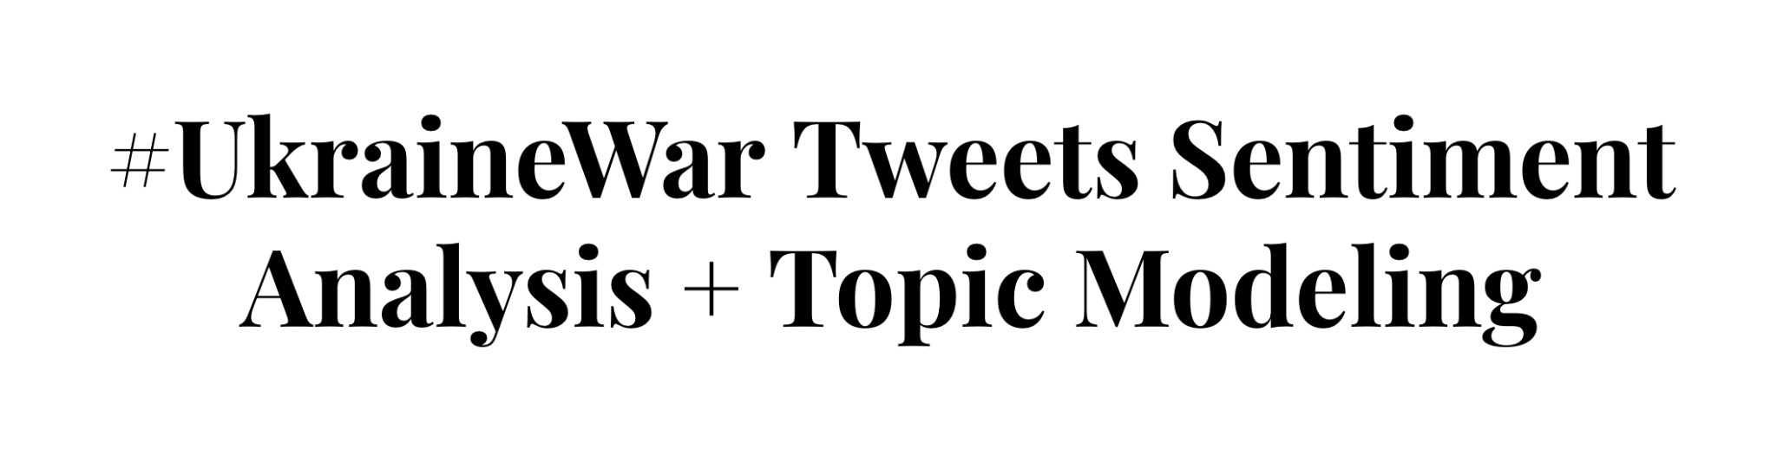


#UkraineWar Sentiment Analysis
+ Topic Discovery
05/13/2022
Brown University
CS2470 Deep Learning

Slide 2
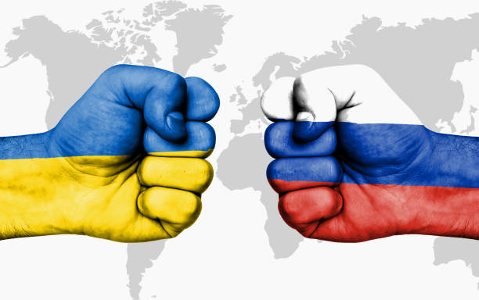
Introduction
The current conflict between Russia and Ukraine has caused people and groups to suffer at different levels and aspects globally.
To better understand English-speaking Twitter users’ reactions to this conflict, we use bidirectional LSTM model to analyze the sentiments and use LDA to discover topics of the discussions. We also visualize our results to explore how the emotions change overtime and possible relations between topics and emotions.

Slide 3
Project Outlook
BiLSTM
🥳🥰😩😒😡🤮...?
Tweets
Preprocess
LDA
Topic Discovery

Slide 4
Preprocessing
Original tweet
RT@NYTimes: ⚡️#BREAKING SUNDAY: RAW VIDEO Of #Russian Column Destroyed By #Ukraine Forces Near #Kyiv
Remove special characters and Retweets
BREAKING SUNDAY RAW VIDEO Of Russian Column Destroyed By Ukraine Forces Near Kyiv
Lowercase and delete words with length < 2
breaking sunday raw video russian column destroyed ukraine forces near kyiv
Remove stop words
breaking sunday raw video russian column destroyed ukraine forces near kyiv
Lemmatization
break sunday raw video russian column destroy ukraine force near kyiv

Slide 5
Sentiment Analysis

Slide 6
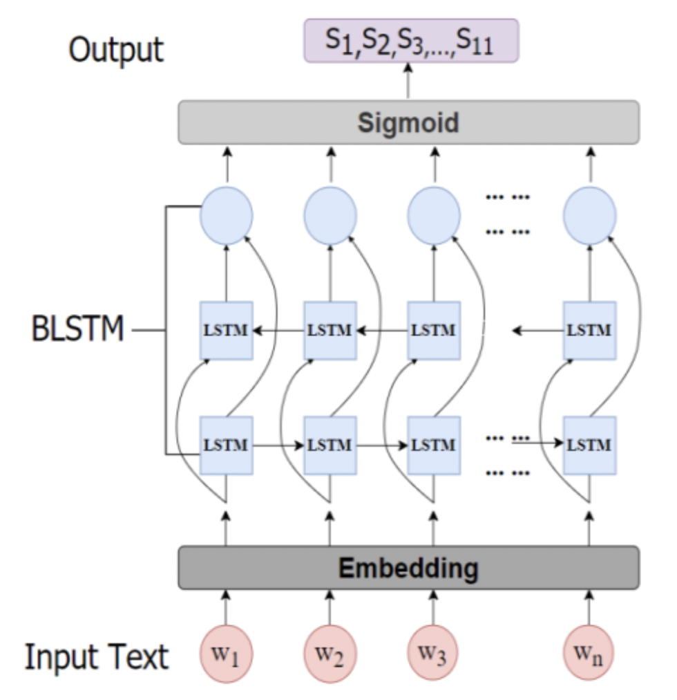
Bidirectional LSTM model for Sentiment Analysis
Embedding layer - GloVe
Unidirectional Long Short - Term Memory
Recurrent neural network learning order dependence in sequence prediction problems
Bidirectional Long Short - Term Memory
Advantage: The bi-directional semantic dependencies can be better captured
Disadvantage: Requires more time for training
Additional Dense Layer with Sigmoid to output probabilities for multiple labels
GloVe

Slide 7
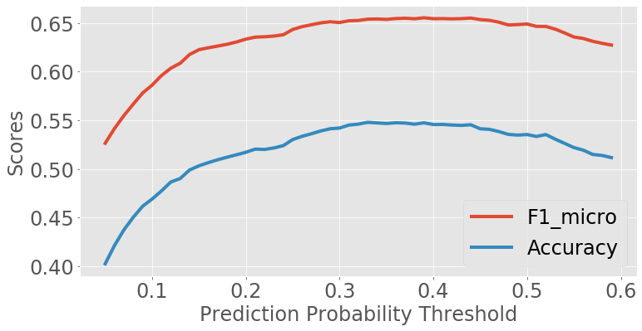
Choosing the threshold
One tweet can be labeled with multiple sentiments that have probabilities above the threshold.
We have chosen the threshold to be 0.37 based on the accuracy and f1 micro score. The accuracy and f1 micro score decrease after 0.37.

Slide 8
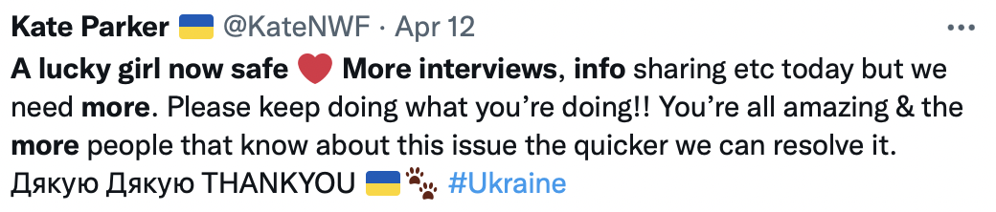
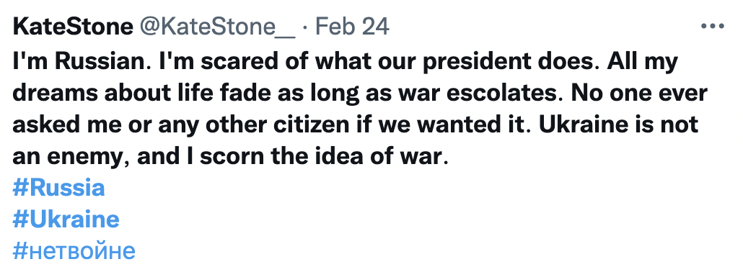
Result Example
JOY 😄
DISGUST 🤮, ANGER 😠

Slide 9
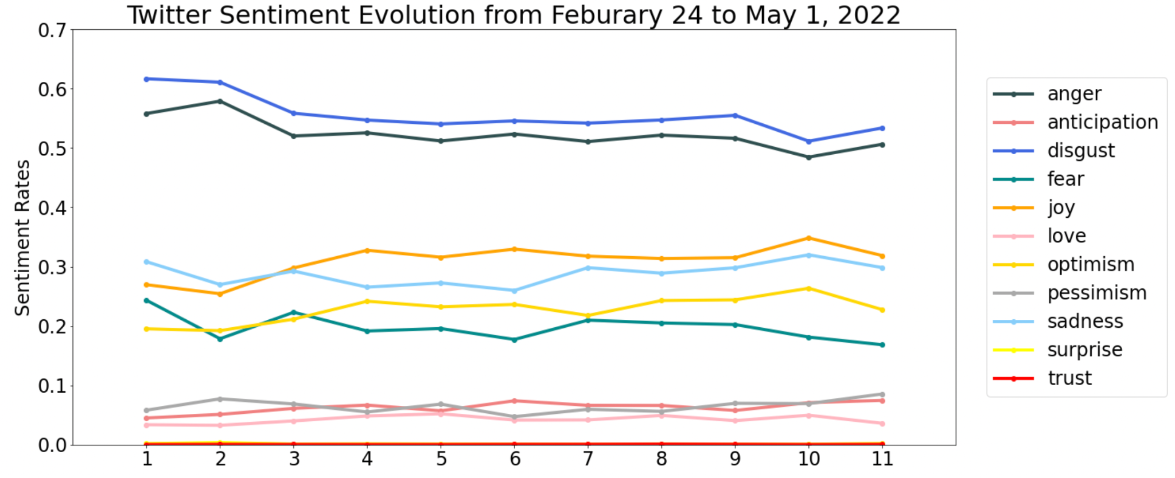
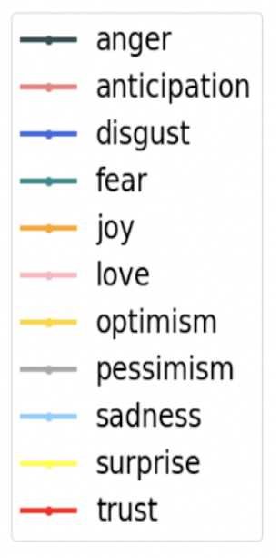
Time trend of sentiments
11 sentiments have been captured
Top 3 sentiments:
1. Disgust
2. Fear
3. Joy
Changes over time:
Gradual decrease for negative sentiments
Gradual increasing trend for positive sentiments
Time

Slide 10
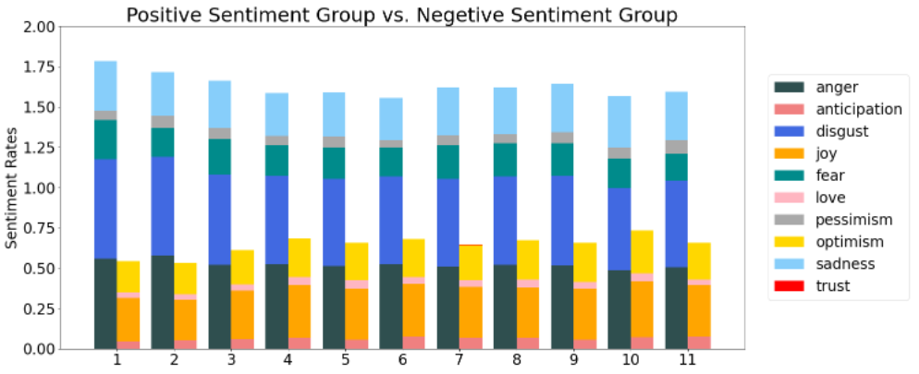
Percentage of Total Positive and Negative tweets

Slide 11

Misclassified Result Example
For tweets that do not strongly associate with any of the 11 labels, the model cannot classify it correctly.
JOY 😄, SADNESS💔
We need to explore more beyond the 11 sentiments…

Slide 12
Topic Discovery

Slide 13
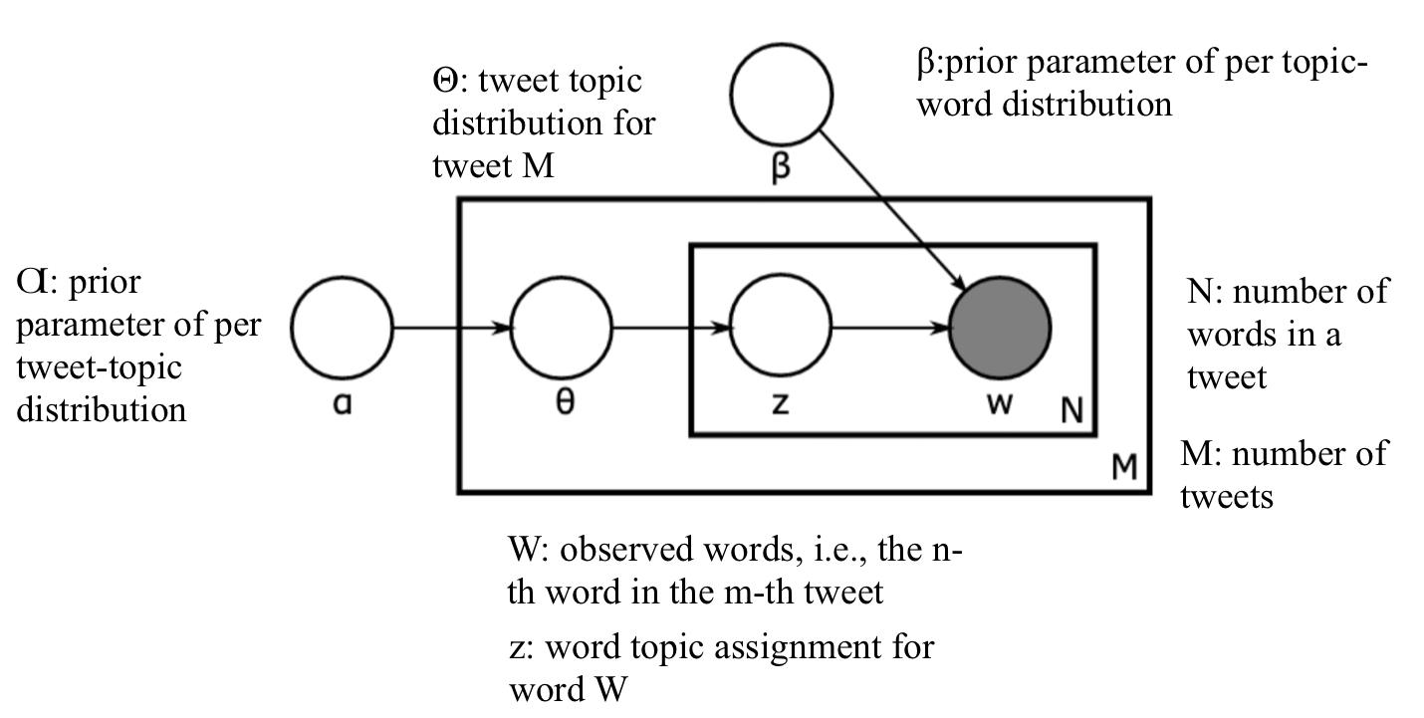
Latent Dirichlet Allocation (LDA) for Topic Discovery
Unsupervised learning method allows us to detect latent topics that govern the words in twitter datasets.
Output a file that contains all the topics made of all the words with their probabilities to belong to that topic
We can conduct human analysis to define such topics more precisely
𝛼: prior parameter of per tweet topic distribution

Slide 14
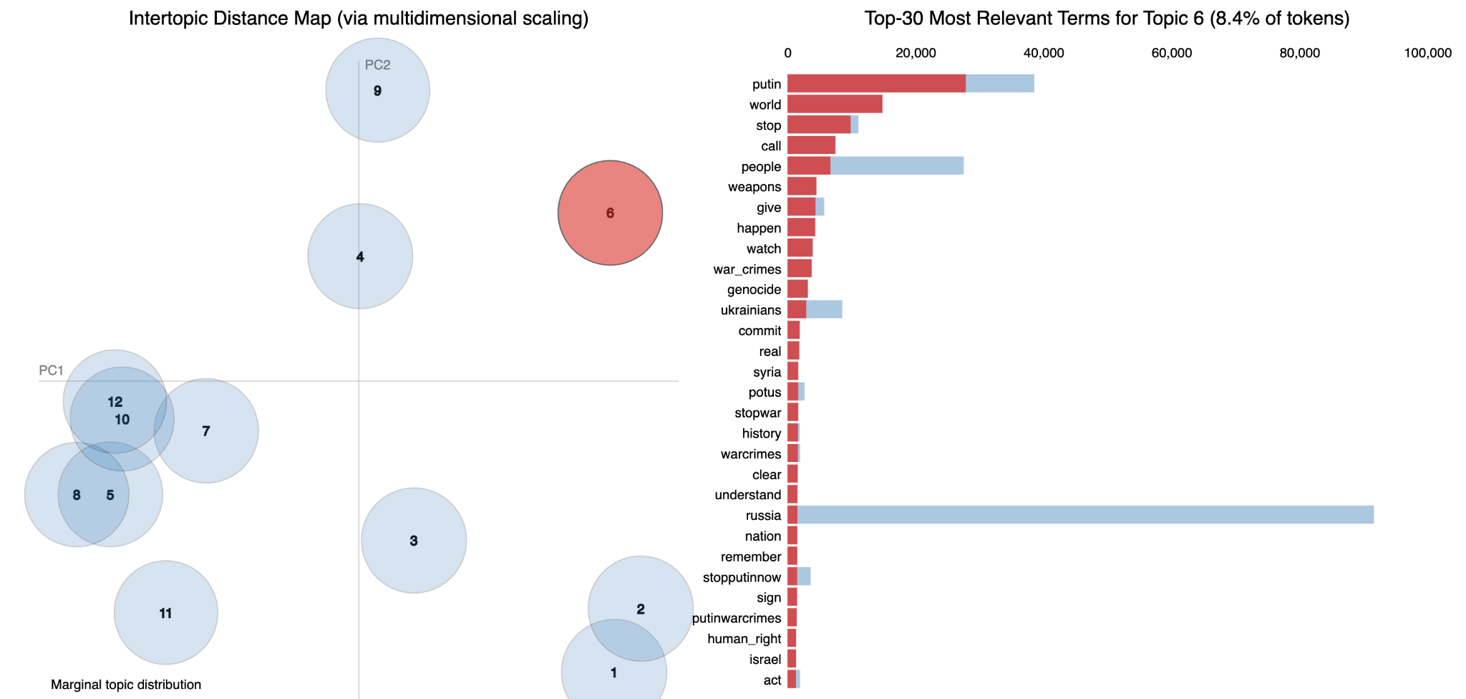
LDA Example Results 1: (Topic “Putin”)
Most meaningful words:
Putin
Russia
Stop putin now
Stopwar
Genocide
War_crimes
Putin War Crime
Warcrimes
Potential sentiment
Anti - War emotion

Slide 15
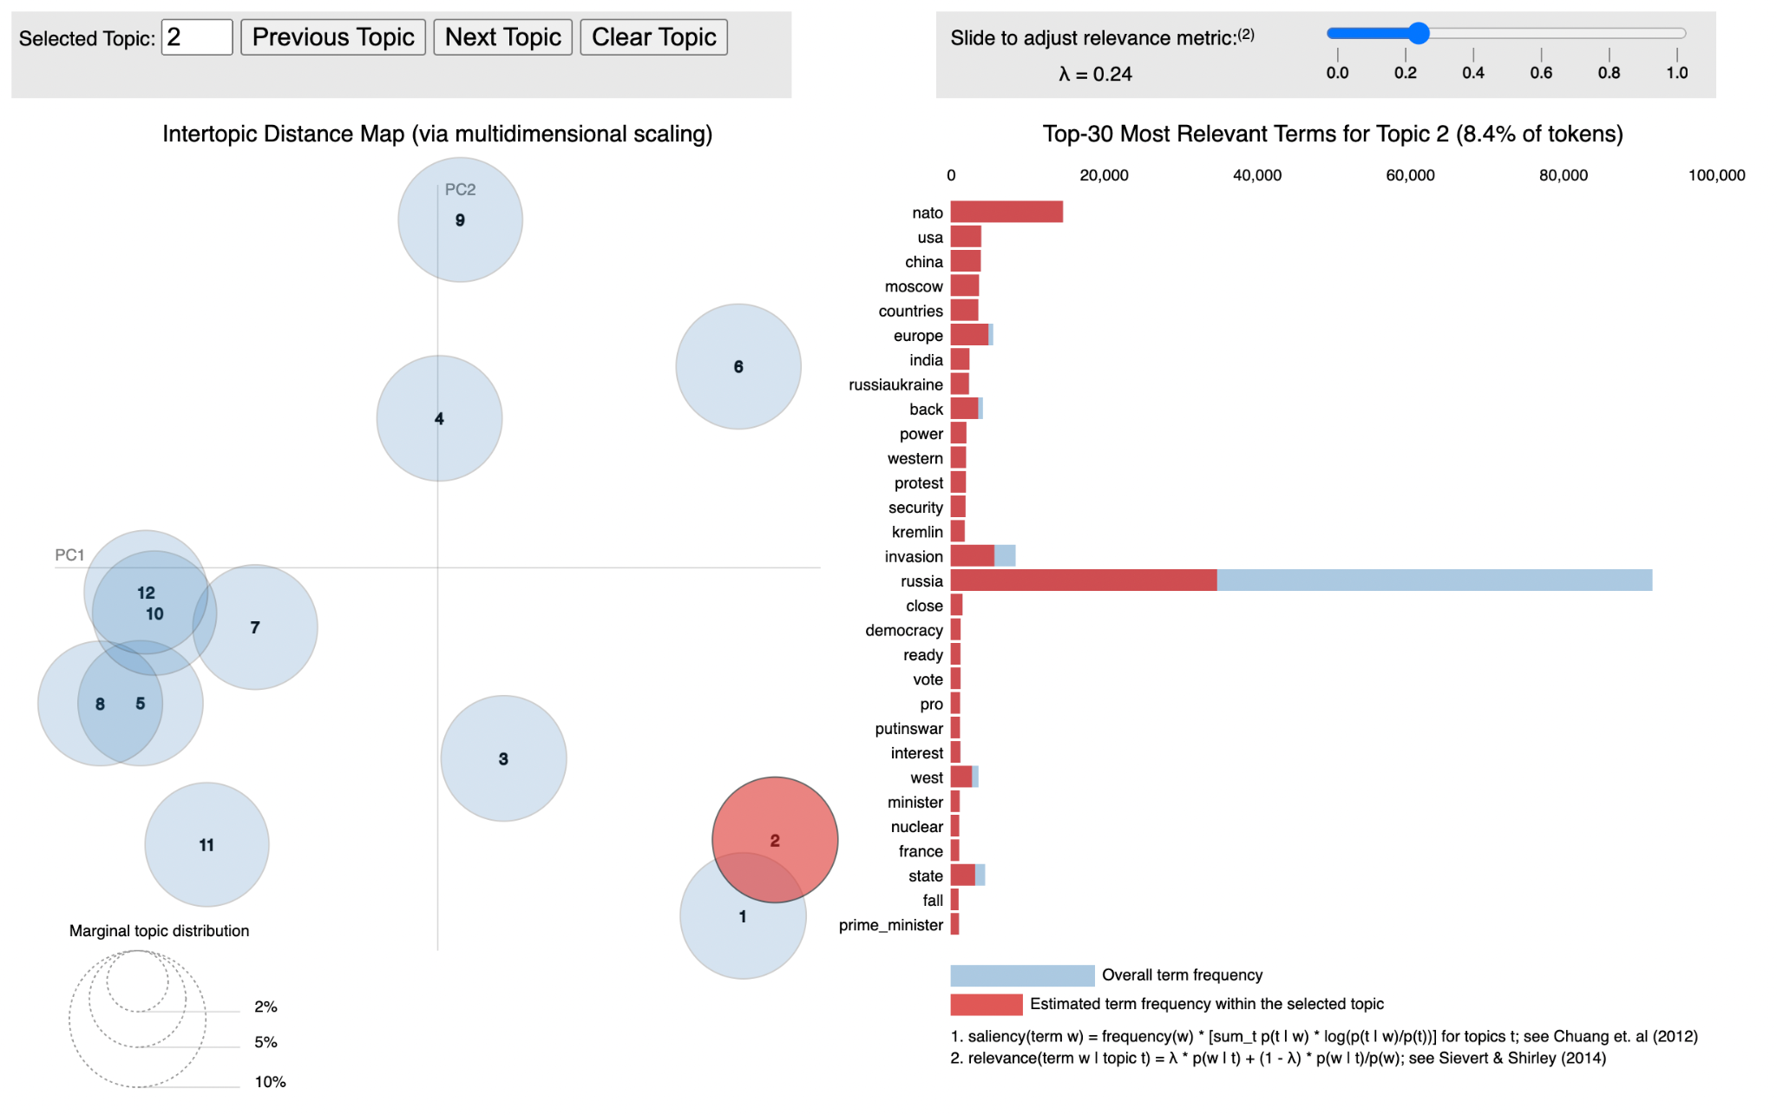
LDA Results 2: (Topic “Zelenskyy”)
Most Significant words:
Ukraine
Zelenskyy
Live
good
Protect
Freedom
Hope
Stand
Love
Potential sentiment:
Supportive
Benefit: Capture some extra sentiments that we have not included in our train dataset

Slide 16
Discussion
The Sentiment Analysis model help us to understand the general reactions to the war between Ukraine and Russia. However, 11 sentiments are not enough for the model to summarize the millions of online discussions effectively. The LDA model helps us to further understand the most concerned topics.
The topic discovery model can help us to improve our sentiment analysis model.
We can explore sentiments with high frequency that are not covered in our 11 labels and add more appropriate sentiment observations to train our model.
Some topic groups from the LDA model show strong attitudes, such as supporting Ukraine. We can introduce a layer to our model after the BiLSTM, which can detect key words from a topic group associated with positive sentiment and increase the likelihood of classifying the tweet as positive.

Slide 17
Thank you for watching this presentation!

